Slide 1
Data Lineage with Tigergraph
Vicente Ruben Del Pino
Tomasz Krol

Slide 2
Agenda
1 | Introduction
2 | Importance of Data Lineage
3 | Data Lineage Framework Spark and Spline Data Flow TigerGraph
4 | Next Steps

Slide 3


Introduction
Vicente Ruben Del Pino
15 years working with data: RDBMS, NoSQL, Big Data
On-Premise/Cloud
https://www.linkedin.com/in/vrdelpino
Tomasz Krol
13 years work experience with different data platforms
https://www.linkedin.com/in/krolthom

Slide 4
Importance of Data Lineage
Data Volume
Explosion of data
GB/TB/PB of data to use
Right data
Use the right data
Enrich Training data sets with right data
Data Lake
No documentation
Realistic situation of data lakes
Time to data
Find right data set
Improve train data set

Slide 5


Data Lineage Framework
Track:
ETL
Data Usage
  Data Science
  Business Intelligence
Automatic:
Analytics Platform
No manual intervention needed
Easy to use:
Cover full platform
Easy to use and explore all data
Open Source:
Open-Source Stack
Cover main tool used: Spark

Slide 6
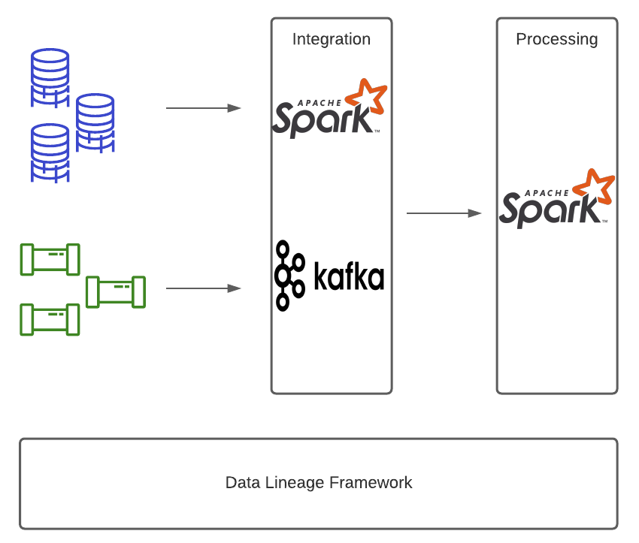
Data Usage ETL

Slide 7
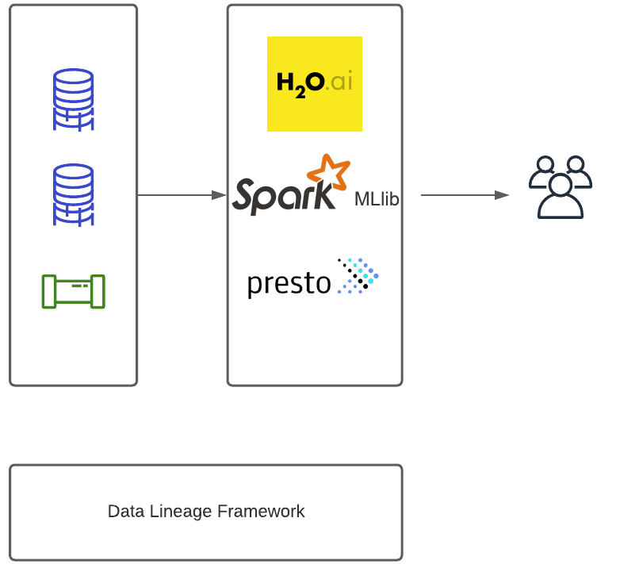
Data Usage ML/BI

Slide 8
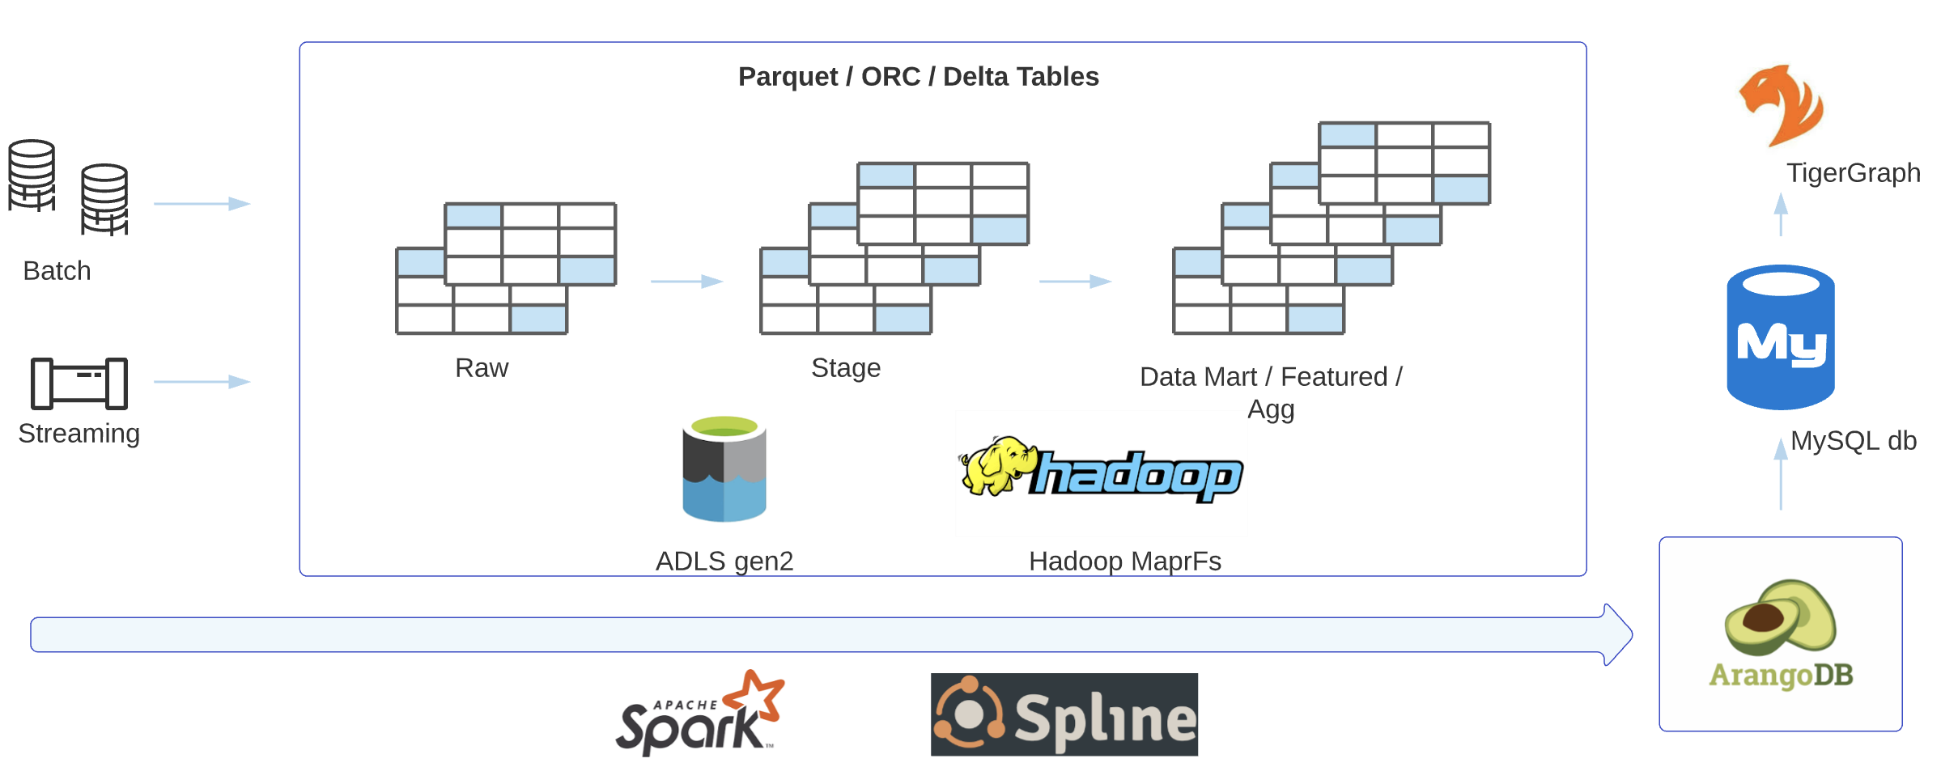
Data Lineage Framework – Design

Slide 9
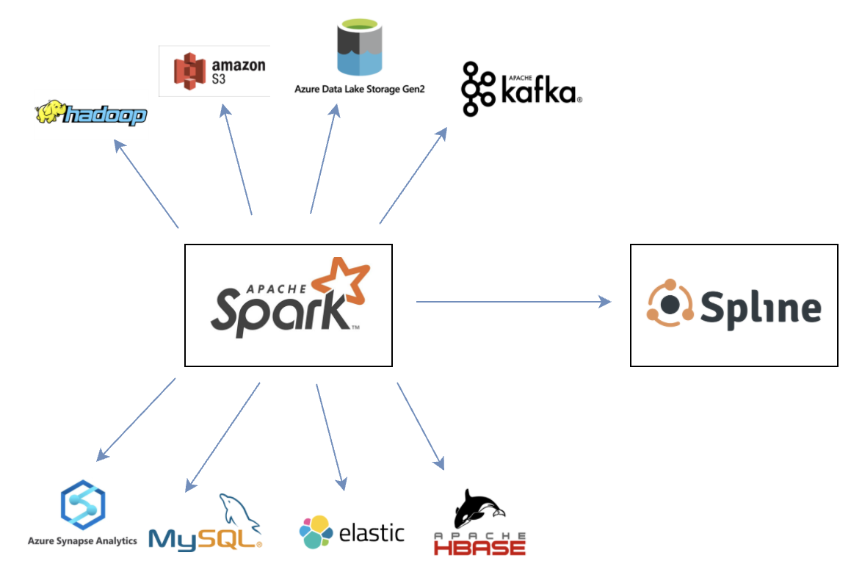
Spark and Spline
Apache Spark
Data processing framework
Perform processing tasks on large data sets
Distribute data processing
On-premise Hadoop and Cloud
Spline
Open-source
Automated tracking data lineage
Easy integration with Apache Spark
Docker images
Stores lineage data collected into ArangoDB

Slide 10
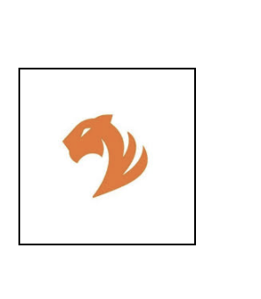
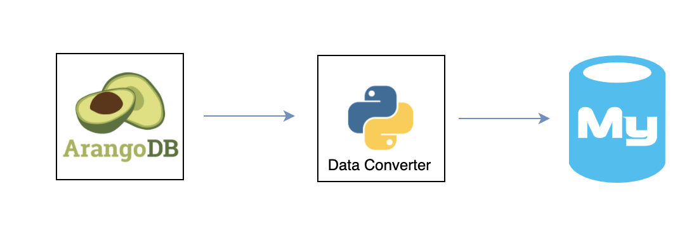
Data Lineage
Data Flow
Data Converter
ArangoDB
MySQL
TigerGraph
Open-source native
Multi-model database
Spline lineage
information database
Python application
Parses and map
unstructured data
Write structured
format to MySQL
Open-source
Relational database
Stores structured
lineage data
Fastest and most scalable graph platform
Massive parallel processing

Slide 11
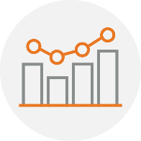

Why TigerGraph?
Specific for graphs
Native Graph DB
Fast Performing
Easy scale out
Privacy features
Easy to use
and explore

Slide 12
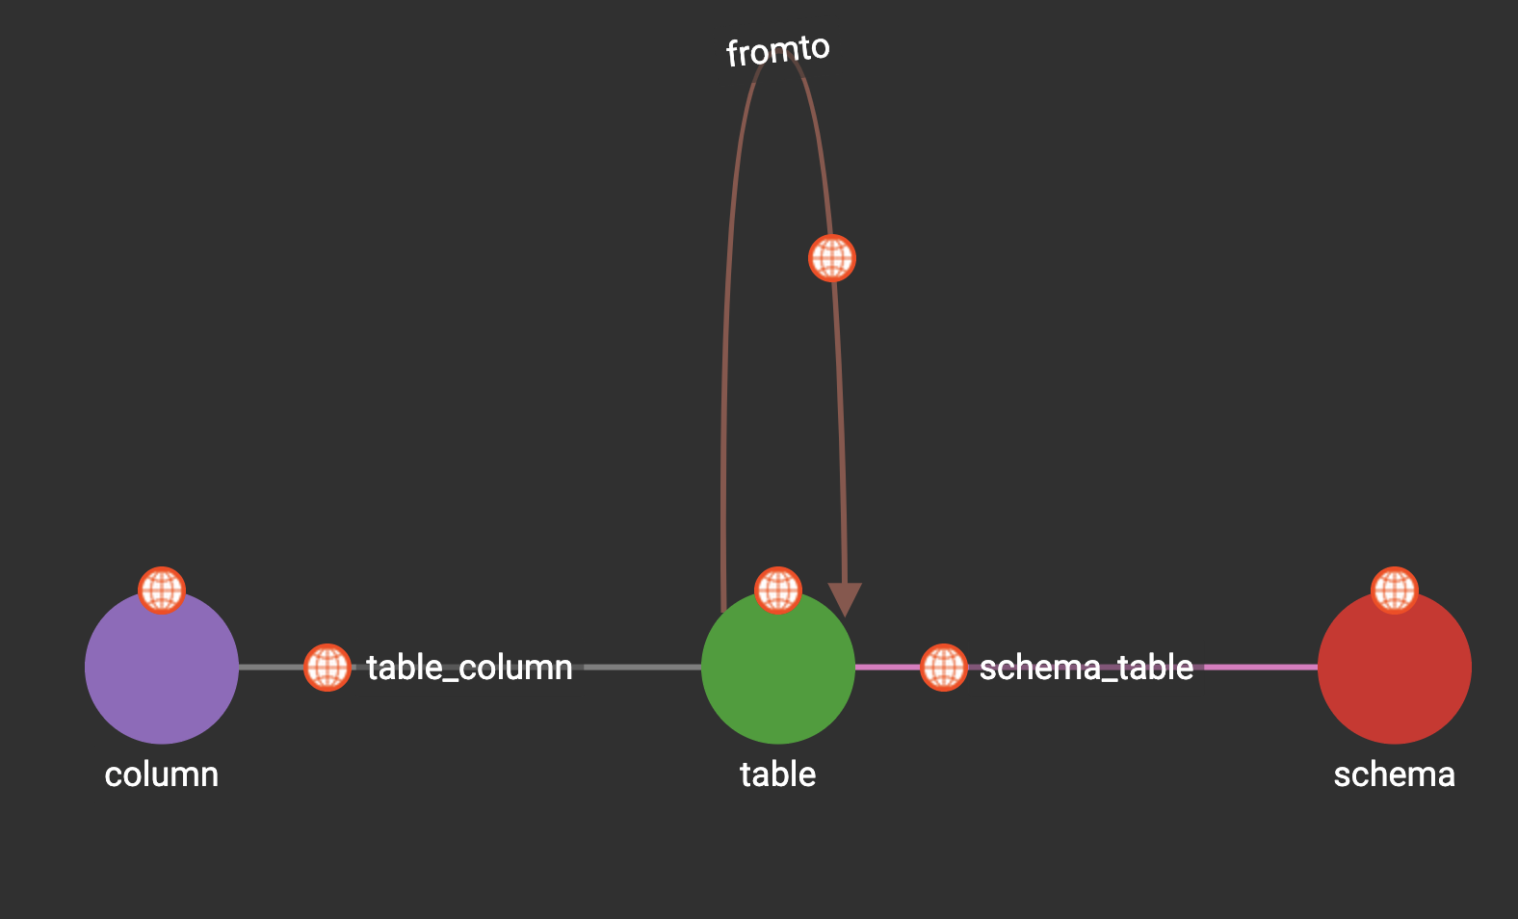
TigerGraph – Schema Design
Vertices
  Schema
  Table
  Column
Edges
  table_column
  schema_table
  from_to

Slide 13
TigerGraph – Data Lineage Analytics (use cases)
Enrich training data
Operations Support
Improve database design
Join tables from different databases
Candidate data sets to use
Dependencies between ETLs
Detect key tables
Tables used together frequently

Slide 14
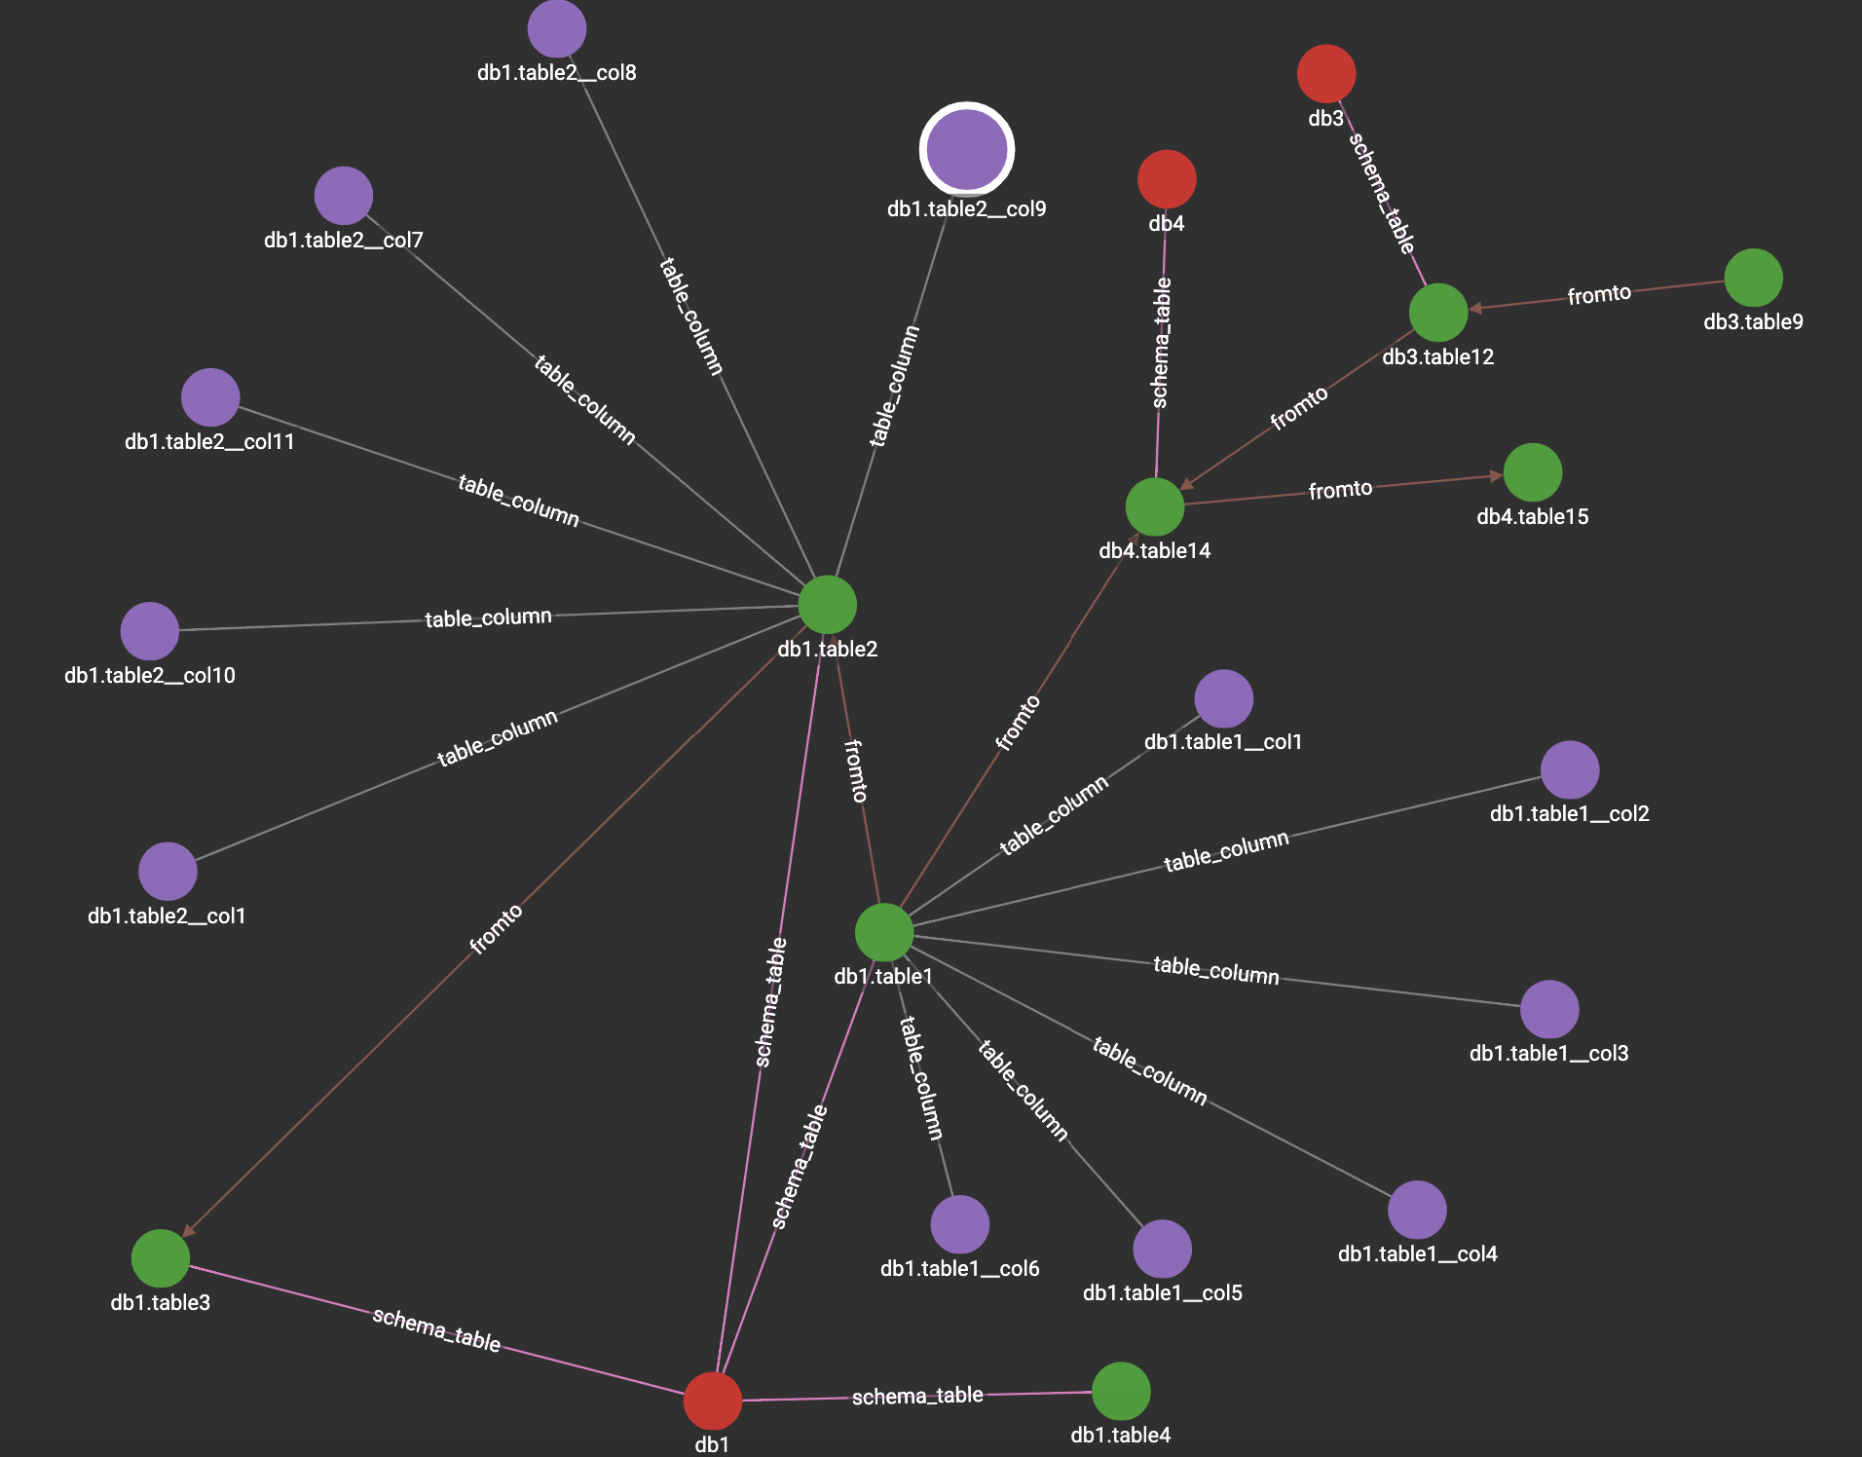
Use Case –
Enrich Dataset
Data Scientist using
  DB1
  Trying to find additional data to enrich the data set

Slide 15
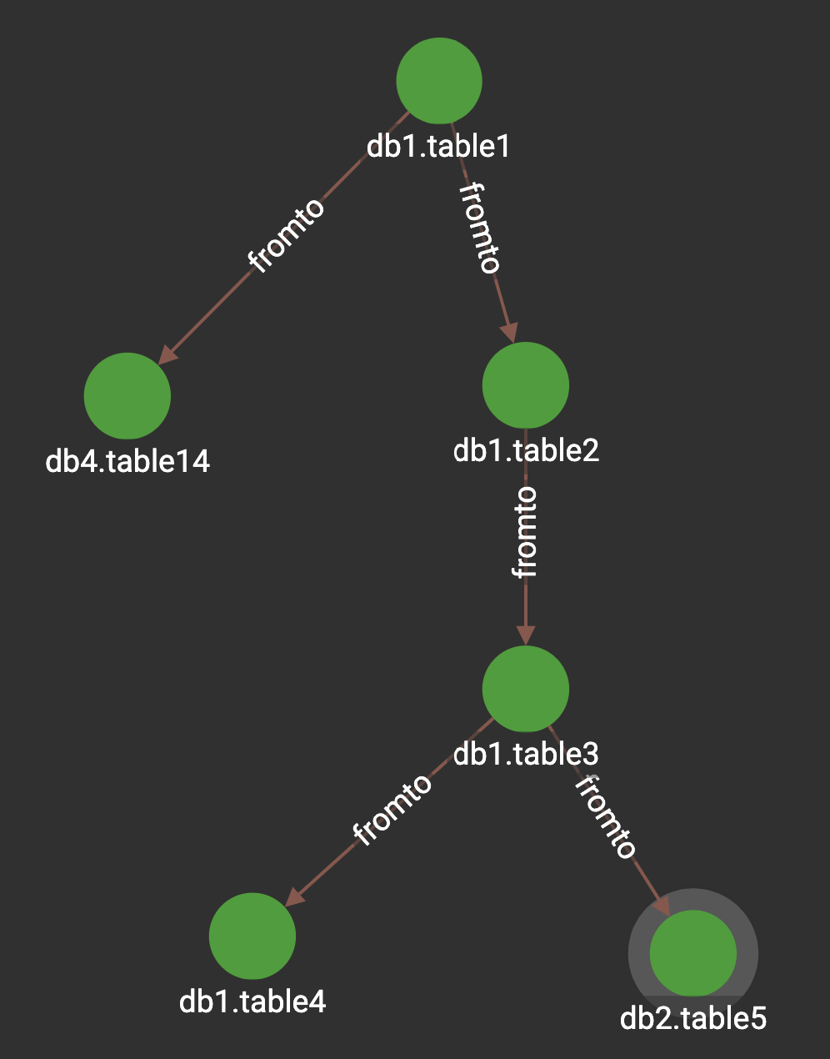
Use Case – Operation Support
Table 1 in DB1 fails
  Find dependencies:
    Table 14
    Table 2
    Table 3
    Table 4
    Table 5

Slide 16
Improve database design
Find tables used together
  Candidates to merge

Slide 17
Next steps
Track sources
Dashboard
Alert system
RDBMS support
Plug In Components
BI suite
ETLs not using right joins
DS not using right data

Slide 18
Vicente Ruben Del Pino
Thank you
Connect with us on:
https://www.linkedin.com/in/vrdelpino
Tomasz Krol
https://www.linkedin.com/in/krolthom

